Slide 1
Get a New Job Professional Development

Slide 2
Get a New Job
We, as employers and supervisors, have all dealt with it… Work stress, job demands and employee burnout, but when it is time to say “maybe this type of job just isn’t for you”.
Sometimes we have employees who get into a particular job or field because they thought they would like it, but in reality, not so much. They don’t like the tasks, or can’t cope with certain aspects of the job, or maybe they could be doing so much more.

Slide 3
Get a New Job
This session is going to explore these types of situations and how to go about having a professional development conversation with your employees.
Do they have skills that can be worked on to get them to the next level in your company? Do they have transferrable skills that might be better suited to a different job altogether? Let’s discuss!

Slide 4
Get a New Job
Overview
Exploring professional development
Identifying strengths, weakness, opportunities and threats
Goal setting
Transferrable skills

Slide 5
Get a New Job
Throughout the course of our lives most of us will have several different jobs. These may be with the same company but in different positions, or with different companies altogether. Some people may even have several completely different careers in their lifetime.
As we grow older, we learn from our personal lives, our jobs, and our experiences. We change, evolve and pick up knowledge and skills along the way.
As we evolve and reach our goals, we often look to “what’s next”?

Slide 6
Get a New Job
What’s Next?
What’s next can be a multitude of things. For example:
Taking on a new project/task/responsibility at work.
Moving to a different position within the company.
Furthering your skills or education.
Taking on casual or part time work somewhere completely different.
Looking for a new job altogether.
Switching career paths completely.
Notes:
Moving to a different position doesn’t always have to mean a promotion. Employees may want to make a lateral move or even take a demotion to work in a position that they enjoy more or find more fulfilling. (and yes, people often think pay is the most important when looking for a new job, but this is not always the case). And just because a different job might start at a lower wage, doesn’t necessarily mean it doesn’t have the potential for way more down the road.
Taking a part time job – I know lots of people who work or have worked office jobs, Monday to Friday, but work a couple weekend days a month at wineries or retail stores simply because it fulfills a need they have to interact with people on a different level or give them the opportunity to do something they are passionate about and still maintain they regular job and lifestyle.

Slide 7
Get a New Job
Sometimes we work for so long and so hard to reach a specific goal or dream, and when we get there, its not what we thought it would be.
But we think, “I came this far, now I’m stuck with it…”.
No one is truly stuck. We all have the ability to take control of our lives and our decisions. Sometimes it can be very hard to make a significant change, but typically we decide based off if the benefits outweigh the challenges.
Notes:
I’m not saying quit your job whenever it gets tough or when you decide you don’t like it. What I am saying is, never give up your passion or your dreams. If you don’t like your situation do something about it. That may mean looking for a different job, but it may also mean looking at ways to make meaningful changes in your company to make it the place you want to work or looking for positions within your company that are more suited to your skills and passions.

Slide 8
Professional Development
So what can we do about professional development for our employees?
Talk to your employees – find out what their goals and dreams are. What are they passionate about?
Be constantly on the look out for opportunities – which employees are showing potential? What positions may open up in the future that you can start grooming employees for?
Notes:
Or self-reflect – is this the job for you? What are your options?

Slide 9
Professional Development
SWOT Analysis
One of the best ways to get started on a professional development track is to conduct a SWOT analysis. With the employees, sit down and identify their strengths, weaknesses, opportunities and threats.
There are many ways this can be done, but I recommend a more detailed approach as opposed to simply just asking the employee: “What are your strengths and weaknesses?”.

Slide 10
Professional Development
Conducting a SWOT Analysis
Develop questions that relate specifically to the employee’s position and the skills required.
Explore additional skills that the employee may have but is not using or, not required in their current position.
Look for opportunities for the employee that relate to their development in their current position, but also for those that could relate to growth potential down the line.
Notes:
Tip – For anyone who may have the potential to take on a leadership role down the line, suggest getting them on the Health & Safety Committee now, so they start to develop some of the knowledge and skills needed for a supervisory position (things like hazard recognition, running effective meetings, having a voice, taking responsibility, making recommendations for improvement).
Opportunities may also include webinars, conferences, training, or projects not related to their current position, but that start building a foundation for future openings within your company.

Slide 11
Professional Development
Conducting a SWOT Analysis
Go beyond just the SWOT questions and ask the employee about their interests and what they are passionate about.
Find out what brought them to this job to begin with? – Is this a stepping-stone for their career? Do they like the industry, or are they just in this position to gain specific skills?
Does the employee have their own professional goals?

Slide 12
Professional Development
Conducting a SWOT Analysis
When looking at weaknesses or threats, don’t treat it like a disciplinary issue. It’s not something where you simply say: “these things need to improve”. These areas help to identify what positions employees may be more suited to, and things that can be improved on with coaching, training, education and practice.

Slide 13
Professional Development
Promoting from within is typically less expensive and more successful than recruiting from outside sources.
You end up with employees that you already know what their work ethic is like, that are familiar with your company’s mission, values and practices, but you also boost employee morale by showing that you invest and believe in your employees.
Notes:
Always be looking for the opportunities within. You may not always have the right person with the company already, and sometimes getting in a fresh set of eyes can be beneficial as well. But promoting from within certainly has a lot of benefits as well.

Slide 14
Goal Setting
Goal Setting
Once you have identified with the employees what their strengths, weaknesses, goals, interests, and passions are, put together a professional development plan with the employee.
Include goals, potential opportunities and skills to work on. Have timeframes for follow up and make sure this activity is documented.
Notes:
The employee should be in the driver seat for this activity. Have them lead the conversation and give them time for self-reflection. This does not need to be done all in one meeting. HOWEVER, do not promise them anything unless you can guarantee you can follow through. This is not a conversation of, it you do this, this and this then one day you will get promoted.

Slide 15
Goal Setting
Goal Setting
Goal setting should not just be writing down what you want your final outcome to be. It should include all the all the goals or steps that you want, or need, to achieve along the way.
Gaining a new skill
Completing a new course
Improving your time management
Taking the lead on a project/ task

Slide 16
Goal Setting
Goal Setting
Goals should be realistic and attainable – you will get discouraged if your goal is not achievable.
Goals should be clearly outlined or defined so you know when you have reached your goal.
Break your goals into smaller steps so you can see your progress and have a better sense of your achievements.

Slide 17
Goal Setting
Goal Setting
Target dates should be set for achieving these goals, so they don’t get pushed to the side.
Have someone to help hold you accountable for your goals or figure out a way to hold yourself accountable. Check in with the employee on a regular basis.
Document progress so you can look back to see how far you have come.

Slide 18
Professional Development
Professional Development Plan
A professional development plan should align the employee’s goals with the opportunities and needs of the company.
Employee’s goals may exceed the needs of the company or may not align with the opportunities within the company but that is okay. Don’t limit the employee’s goals just because there may not be the right opportunity for them there.
Notes:
Professional development is intertwined with personal development. Encourage the employee to work towards all their goals even if it means that they will one day leave the company. The result will be employees that have a passion for what they are doing, that will bring their best self to work, and will always be striving for bigger and better things for both themselves and for your company while they work there.

Slide 19
Get a New Job
Time for a new job?
But what happens when you have an employee that is not a good fit? Or one that just seems to hate their life when they are at work? The ones who just don’t like the job or can’t cope with conditions that are inherent to the position?
How do you deal with someone that has given up their passion for the job?

Slide 20
Get a New Job
It might be time for them to start looking for a new job. Now you can’t come right out and say: “maybe its time you start looking for something else”, so what can you do?

Slide 21
Get a New Job
Working from the professional development plan, you will want to have a conversation with the employee.
Find out the things that they really struggle with in their job.
Are these things that can be improved on? – process changes to make things run smoother, or employee conflicts that can be resolved? Work-load issues that can be redistributed or fixed with extra staff?
Are these things that are inherent to their job? – Fire fighter doesn’t like working in hot environments, or a health care worker can’t cope with clients who have mental illnesses?

Slide 22
Get a New Job
For issues that can be improved upon
Work with the employee to find the root causes of the issues and come up with potential solutions.
Remember, finding the root cause involves asking why, a lot!
Notes:
Sometimes all it takes is a staffing change within the organization to change the whole mood of the environment.

Slide 23
Get a New Job
For issues relating to inherent aspects of the job
Talk to the employee about their options.
Are there strategies for coping with those aspect of the job?
Look at the employee’s goals and skills discussed during the professional development – do they have any skills that would be transferrable to other positions?

Slide 24
Get a New Job
For issues relating to inherent aspects of the job
Are there different types of jobs in the same field that the employee may be more suited for?
Does the employees have skills that would be well suited for a different type of employment?
Notes:
For example: a fire fighter who doesn’t like hot environments may want to consider looking for a job as an fire inspector, or with a company that provides fire equipment in buildings and workplace. Or a Heath Care worker who doesn’t like dealing with ill patients may want to consider working in public health or health care education.
There are lots of jobs out there that we don’t often think about. Sometimes we just need to do a bit of research to see what options are out there that relate to our field.

Slide 25
Transferrable Skills
What are Transferrable Skills?
Transferrable skills are the skills that an employee has that can be used in many different types of jobs. This may include things like:
Communication
Adaptability
Technology literacy
Leadership
Problem solving
Organization

Slide 26
Transferrable Skills
Transferrable Skills
For some employees it may not be the particular job that they don’t like, but rather the industry they are working in. But sometimes they get stuck thinking that they only know this industry and that is all they are qualified to do.
Speak with them about their transferrable skills and see if you can get them to brainstorm other jobs or areas of interest where they may be able to apply those skills.
Notes:
Getting them to brainstorm may help them put the idea in their head that they are not stuck and may encourage them to explore other options or things they may not have considered before.

Slide 27
Transferrable Skills
Examples of Transferrable Skills
A retail worker may have very good communication, problem solving, teamwork and customer service skills. These skills could also be beneficial for jobs in marketing, HR, office environments, project management, etc.
Notes:
Just because someone has the skills that transfer over doesn’t automatically mean they are qualified for a position in one of those fields, but it means that they have a good basis, and with some coaching, education, training, or experience, they may be able to switch into a new position or career.

Slide 28
Get a New Job
Let’s face it. Not everyone is in a situation where they can pick up, quit their job and follow their dreams. But that doesn’t mean they can’t look for ways to be fulfilled in the job or career they have chosen.
Switching careers may be the best option for some employees. For others, working their way through the company or the industry may keep them fulfilled.
Either way, supervisors and managers should be encouraging employees to be constantly developing their skills, knowledge and abilities.

Slide 29
Conclusion
Conclusion
Make time to have professional development conversations with your employees.
Let employees lead those conversations and don’t put any limits on their goals.
Look for potential opportunities and plan for the future – just because someone is not qualified right now, doesn’t mean they won’t be after some coaching, education and experience.
Have conversations with employees that are unhappy or struggling – is there anything you can do to help?
Notes:
For those employees that just aren’t suited to the type of work they are in – help them see that they are not stuck. Brainstorm with them to come up with ideas that will help them be fulfilled in their professional life.

Slide 30
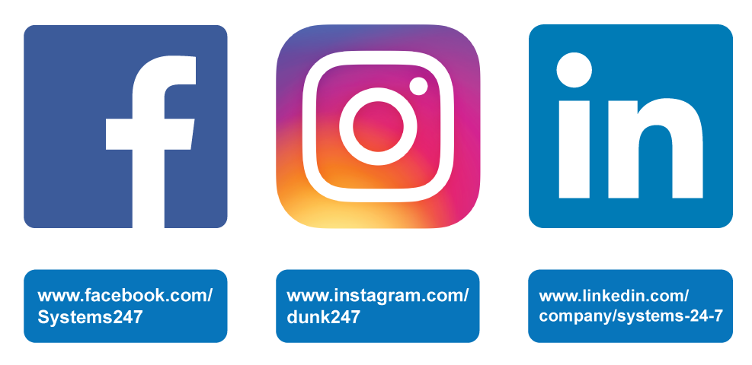
Get Connected!
Get connected by following us on social media! We share tips and important information about your programs and services.
Let’s talk!

