Slide 1
Never Too Early To Plan For Winter
You should be able to hear music playing, if not please adjust your speakers or call our office for assistance at 1-866-754-8839. We will be starting promptly at 1:00 PM ET.

Slide 2
Introductions
Nancy Dunk

Slide 3
Step One
Gather the Information/Data

Slide 4
Winter Hazard Assessment
What do we know, what is new!
First, look to the information you already have on hand.
Review your known hazards – Hazard assessment
Review your inspection reports, accident and injury reports
Where did incidents occurred last year?
Review last years hazard reports
What controls do you already have in place?
Were they effective last year?
Do not forget the non-routine work like decorations!

Slide 5
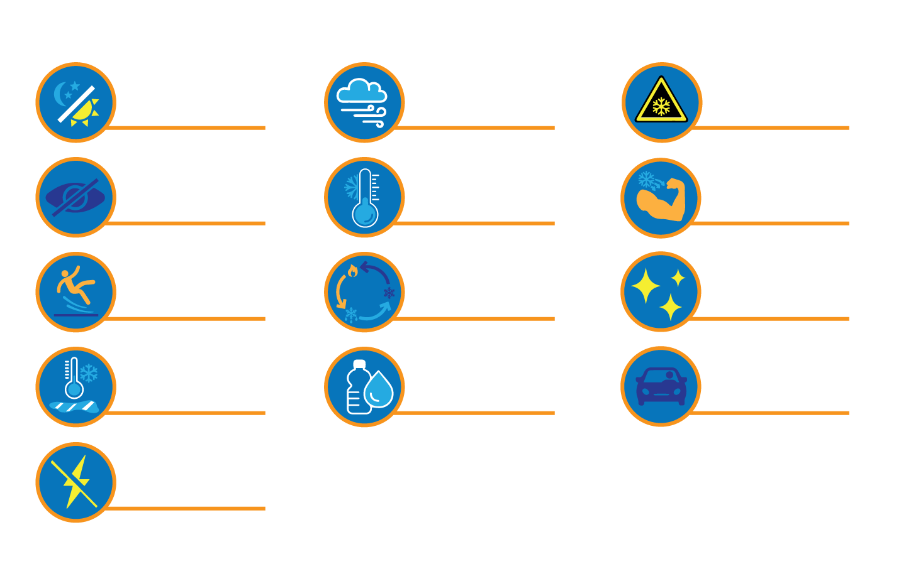
Common Winter Hazards
Dark early
High Winds
Cold surfaces
Low visibility in snow, rain and sleet
Bitter Cold
Cold muscles
Warm, Thaw and Freeze Cycle
Slippery surfaces
Snow glare
Flash freezing of puddles
Dehydration
Driving hazards
How does COVID impact these hazards?
Power Outages

Slide 6
Get Input, Ideas, Suggestions
Survey employees
What are their concerns
What winter recommendations do they have
Speak with contractors, visitors, patrons
Are there areas of decay around your workplace that may cause new hazards this year?
Damaged building materials that may fall
Leaking downspouts or eaves on your buildings
Tree roots, heaving pathways
Low lying areas where water is accumulating and will freeze

Slide 7
Maintenance and Equipment
Do you need to perform a pre-winter inspection to learn of the new or reoccurring hazards?
Is maintenance of the building up to date?
Pipes
Ceilings
Roof
Is winter equipment ready
Vehicles
PPE

Slide 8
What about COVID-19
What is changed in winter prep for 2020 because of covid-19?
Screening means people standing outside your workplace
Outdoor spaces are being heated
Propane
Emissions
Locker rooms, winter clothing storage
Indoor activities means decreased space for physical distancing

Slide 9
Step Two
Required Actions

Slide 10
What Actions are Required
Who will do this work?
Team, person, Safety Committee – involve stakeholders
What are the uncontrolled or under-controlled hazards/risks
List them out
Each of these will require a plan of actions
What are the timelines
Now for ordering
PPE, salt, sand, cones, outerwear
Communication – to everyone on the hazards, areas of concern and reporting
Training – for those responsible for controlling the hazards
Plowing, salt, sand
Vehicle preparation and checks
Ongoing Evaluation of Controls and Follow-Up

Slide 11
Plan Layout
Item to be Action: Plow Equipment to be Prepared for Winter
Assigned to: MaryAnn
Timeline for Completion: November 15th
Actions Needed:
Order repair on XXXX equipment and check stock of shovels and scrapers to aid in plowing
Order maintenance (plow secured, oil check, tire pressure check) on snowplow
Communicate to all employees when equipment will be ready and how to order a clearing of pathways and lots
Refresher trainer for all operators
Because of COVID-19, train one new operator incase of staff shortage

Slide 12
Example Plan #1
How does COVID impact this Plan?
Emergency Preparedness in Winter Season:
Physical Building
Exits
Parking
Sprinkler Systems
Lighting
Evacuations
Gathering areas
Protection of Evacuees
First Aid
Extra precautions
Supplies
Transportation
Plan for Emergency Preparedness
Item to be Action: Perform winter inspection, check supplies and processes.
Assigned to: Peter
Timeline for Completion: November 5th
Actions Needed:
JHSC perform winter inspection on physical building
Check gathering areas and protections for evacuees – remember physical distancing requirements
Purchase additional supplies for first aid in case supply line is interrupted with COVID
Transportation of injured workers will be by ambulance or taxi this winter, notify all staff and First Aiders

Slide 13
Example Plan #2
How does COVID impact this Plan?
Vehicle Winter Plan:
Company vehicle, personal
Daily or pre-use inspection checklist for winter
Tires
Safety Kit
Heat source, food, blanket, shovel, sand/ice
Cell phone, tracking of employees in travel – check-ins
When to refuse
What is your off the road rule? When school buses are pulled?
Plan for Vehicles – Company and Personal
Item to be Action: Ensure vehicles are ready and assist employees to understand the hazards and controls.
Assigned to: Maintenance Department - Susan
Timeline for Completion: November 20th
Actions Needed:
Ensure all company vehicles are winter ready – use winter vehicle checklist
Share this checklist with all staff and encourage them to prepare their personal vehicles
Order new snow tires for vehicle 345,23,2434
Buy a supply of ice scraper and snowbrushes to put in buckets in employee parking lot to ensure they have the tools to clean their cars
Company drivers are to all have completed their winter driving review by Nov 1

Slide 14
Example Plan #3
How does COVID impact this Plan?
Winter PPE Plan
All departments need a PPE review
Does COVID-19 change the requirements, type or usage?
Supply risks?
Ensure training specific to PPE in winter
Cleaning and maintenance of PPE must be monitored during monthly inspections
Plan for Winter PPE
Item to be Action: PPE requirements, ensure supply, and training as needed
Assigned to: All Department Managers
Timeline for Completion: November 15th
Actions Needed:
Review PPE requirements for winter months
Ensure properly rated clothing is used and where needed reflective – thermal inner wear, non-slip footwear, safety glass that protect from snow blindness
Order ASAP and train upon receiving of PPE
Ensure fit, comfort and employees know how to maintain and ask when supply is low.
Ensure at least a 15% overage when ordering

Slide 15
Plans are Executed, now What?
Ongoing Evaluation
Are there new hazards?
What reports have you received?
What injuries have occurred?
Are controls adequate?
Make Improvements!
Never ending, we are always looking for where we can be better, safer.
Keep good documentation of what you have done, improved and how you encourage your employees to be a part of the safety program.

Slide 16
Culture
Create that strong safety culture this winter
Involve all employees
Share what you know for them at home
Be Well, Be Safe!

Slide 17
Call to Action
If you have any questions, please feel free to email us at info@systems24-7.com or by phone at 1-866-754-8839.
Make sure to visit our website for any news and more at www.systems24-7.com.
Thank you for participating in our Safety webinar. Make sure to register for the next one coming up.
Have social media? Make sure to follow us! We share tips and important information about our programs and services. Let’s Talk!

