Slide 1
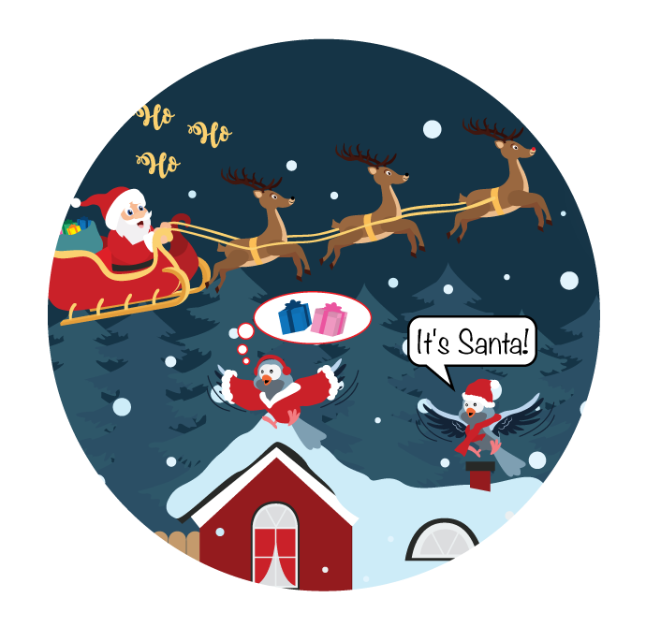
Culture Creatures
You should be able to hear music playing, if not please adjust your speakers or call our office for assistance at 1-866-754-8839. We will be starting promptly at 1pm EST.

Slide 2
Overview
A fun look at workplace culture and the creatures we are at work. Dunk will share some of our learnings in 2020 and what we are working on for 2021 to help your workplace culture.

Slide 3
Who Are You at Work?
A growling bear
A sheepish bird
A prowling lion
A yippy dog
A snarky cat
A loving pet
A smiling monkey

Slide 4
What Did We Learn in 2020?
Kindness is not easy
People swear when frustrated
Fur babies are good listeners
We know what PPE means
We can make faces behind a mask
Sassy is in!
Moistly speaking is not good!
We do not want to repeat 2020 - ever!

Slide 5
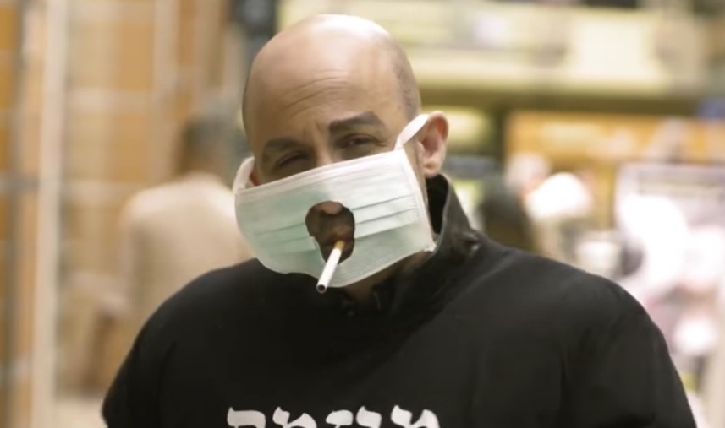
Smokers are Persistent

Slide 6
How Are the…
The kids are fine!
They are on their phones, computers and tablets all day. They don’t stop eating and PJs are never ever coming off again!
We are in an unsettling reversal of my teenage years; I am now yelling at my parents for going out!
Oh nowwww everyone wants to know what introverts do for fun!

Slide 7
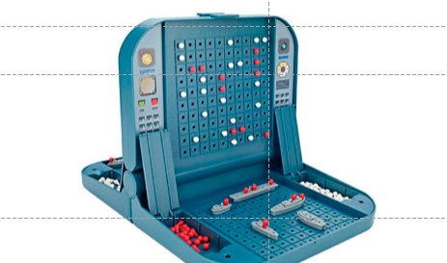
When the Navy works from home

Slide 8
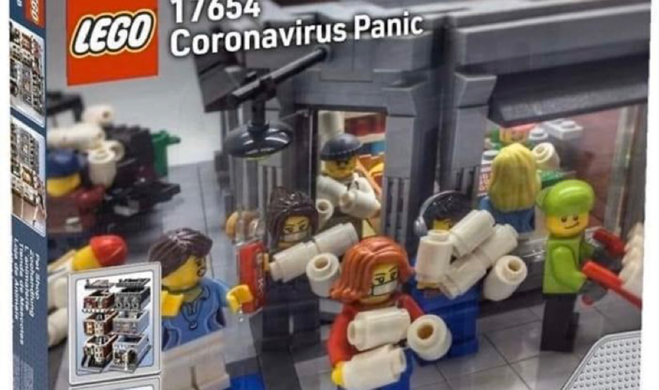
Hottest Christmas Lego Gift in 2020

Slide 9
Conversations in 2036
“Why is my sister’s name Paris?”
Because we conceived her in Paris”
“Thanks Dad”
“No problem, Quarantine”

Slide 10
We Salute the Innovators

Slide 11
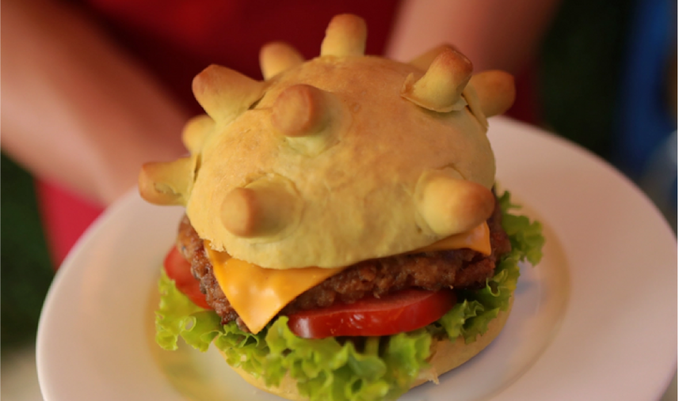
What Innovations have you made?
The “Corona Burger”

Slide 12
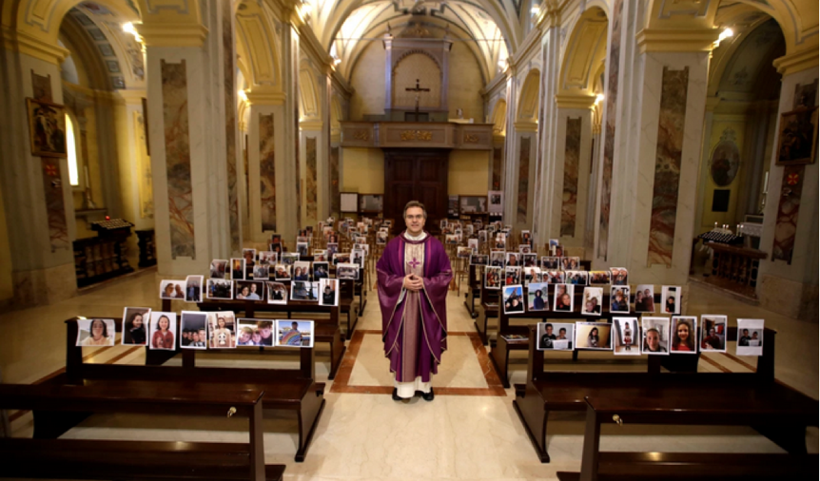
Church in 2020

Slide 13
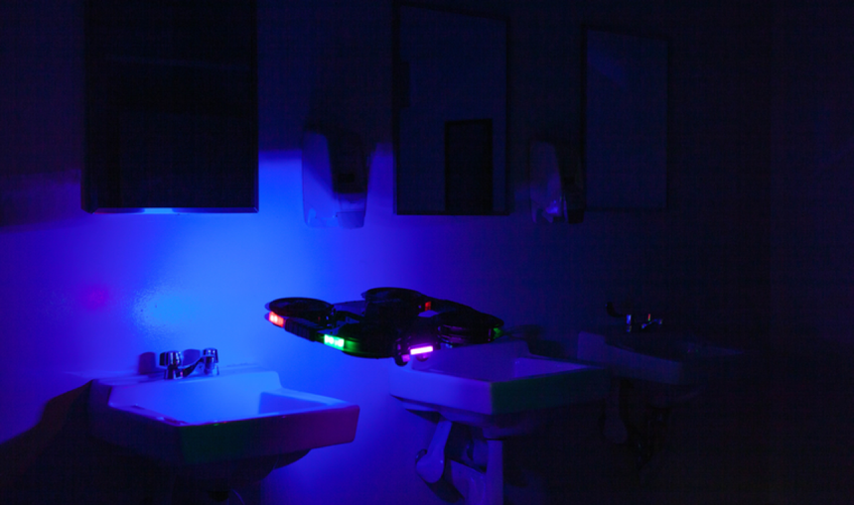
Drones providing indoor disinfection

Slide 14
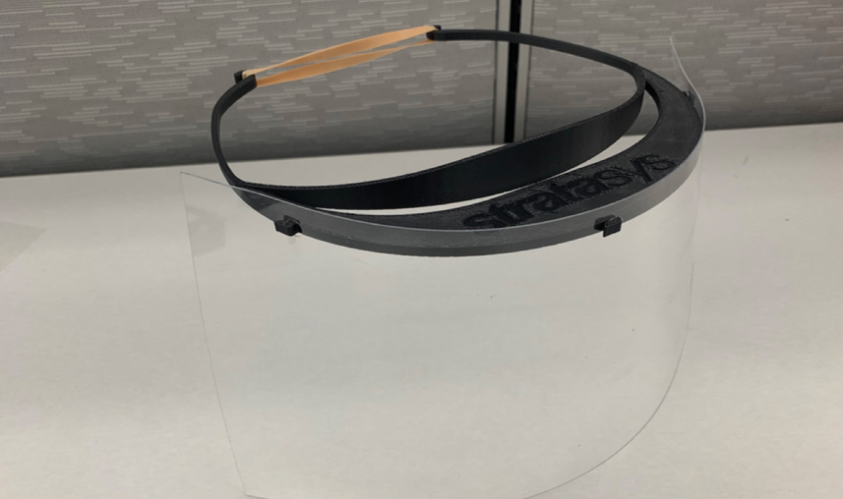
3D Printed Frame and Shields

Slide 16
Dunk Culture Impact in 2020
Virtual Workplace – 100%
4 – day work week
We had some miserable moments
Mental work is more exhausting then physical
Struggling to look forward, we do not seem to be satisfied with where we are at in our present moment – maybe that is just me?

Slide 17
Dunk Where to in 2021?
Worklife Plan for all Employees
Not engaged we will help you plan the exit
Need a challenge – got that for you
Like where you are – great, that core competency is important to our business
For our clients – new approach
Getting the buy-in
Management and Supervisor skills training
New features and initiatives
Comics
Gaming

Slide 18
Where Will You Be in 2021?
This is up to us!
Who do we want to be?
What culture changes are you going to make?
Happiness is a choice.
Giving, reaching out, go beyond who you are – this is what makes us better.

Slide 20
Call to Action
If you have any questions, please feel free to email us at info@systems24-7.com or by phone at 1-866-754-8839.
Make sure to visit our website for any news and more at www.systems24-7.com.
Thank you for participating in our Safety webinar. Make sure to register for the next one coming up.
Have social media? Make sure to follow us! We share tips and important information about our programs and services. Let’s Talk!

