Slide 1
WORKPLACE HARASSMENT
Why the Increase in Incidents and What to Do About Them!

Slide 2
ABOUT DUNK & ASSOCIATES INC./ SYSTEMS 24-7
Dunk & Associates
Systems 24-7
Provides the resources and professional supports needed:
Safety and HR Consulting
Accountability and Program Compliance
Policies, Forms and Training
Resource Library
Newsletters
Complimentary Monthly Webinars
The online platform is used for business management and employee engagement.
Secure access to your program materials (policies, SOPs, forms, safety talks, etc.)
Online Training & Tracking
Course Development Tools
Internal communication and news updates
Unlimited Tech Support

Slide 3
Systems 24-7 Expo
Sign up here:

Slide 4
AGENDA
What Caused the Increase in Workplace Harassment?
How to Determine Workplace Harassment
In this webinar, we will be discussing the following:
Workplace Harassment Investigations and Documentation
Workplace Harassment Solutions
Workplace Harassment Prevention
Slide 3 of 20

Slide 5
WHAT CAUSED THE INCREASE IN HARASSMENT?
Covid-19 caused more remote work
Stats show harassment increased significantly in the last 2.5 years.
While most of us would assume remote work meant less contact with employees and thus less harassment – not what happened.
The Purple Campaign (US company dedicated to addressing workplace harassment) posted some interesting findings:
Remote work and video calls encouraged and allowed personal harassment.
“Nice display case in your background, I can see all the empty bottles, I guess you’re a drinker.”
“I like your top, wonder what you are wearing on the bottom.”
On average harassment complaints increased by over 25% and is still on the rise.
Slide 4 of 20
Notes:
https://www.purplecampaign.org
In addition to remote work, Covid caused a major change in work environment/process- and quickly. Some examples include:
Less employees - increase in working alone or working with a skeleton crew can cause opportunities for workplace harassment situations to arise. Either customer to employee or employee to employee
New controversy: mask/no mask, vaccine not vaccine, caused friction amongst staff
Lots of changes to the work, curbside, closures, reopening etc.

Slide 6
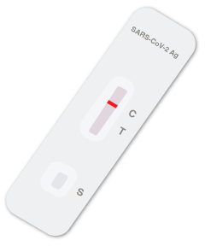
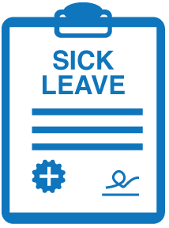
WHAT CAUSED THE INCREASE IN HARASSMENT?
Covid-19 caused higher absenteeism
Employee absenteeism is not easily managed
Employees Testing positive for COVID
Covid Test result requests from managers perceived as harassment
Employees calling in sick
Doctors note requests perceived as harassment by employees
Unable to ask for doctor notes due to health care system overload
Employees refusing to come to work
Inquiring if employees will be coming to work perceived as harassment by employees
All leading to staff shortages causing increased stress among employees and increasing the risk of workplace harassment.
Slide 5 of 20
Notes:
Employees were given a bit of a “get out of jail free card” as far as absenteeism due to illness- employers were not allowed to ask for doctor's notes at certain times (some still aren’t able to in parts of Canada) to support the absence, this can lead to employees abusing the system causing an increase in absenteeism, in addition to the high number of valid covid related absenteeism that was going on.

Slide 7
WHAT CAUSED THE INCREASE IN HARASSMENT?
Covid-19 related Labour Shortage:
Limited candidate pools leading to desperate recruitment efforts i.e.:
no background checks
no formal interview – only discussing availability and start dates
no reference checks
Fast track start dates:
Minimal or no training (on-the-job or e-courses)
Slide 6 of 20
Notes:
No interviews or references could lead to hiring employees that are not a good fit for your company.
Fast-tracked start date leads to less training: on-the-job and online training- this could lead to employee conflict – something that often results in allegations of workplace harassment.

Slide 8
WHAT CAUSED THE INCREASE IN HARASSMENT?
Other Factors - Social Media
The increased use of cell phones and social media apps makes it so easy for employees to connect, and in some cases, harass
Types of social media harassment include:
Virtual harassment
Cyber stalking
Textual Harassment
Virtual harassment occurs when an employer, supervisor, employee, or co-worker sends offensive comments or messages to/or about another colleague through social networks like Facebook, Twitter, Instagram, etc.
Cyberstalking is a situation where a co-worker harasses another employee by following everything he or she does on a social website or blog post as a form of intimidation. A group of workers can also create a blog post or website to harass other employees.
A situation when an employee intimidates or harasses another by sending inappropriate messages to a fellow employee.
Slide 7 of 20
Notes:
Employees should know that using electronic devices to send offensive information to fellow employees, whether on or off duty, qualifies as workplace harassment. Employers should enforce policies that will help in reducing cyberbullying.

Slide 9
WHAT ARE YOU EXPERIENCING?
Survey
Let's do a quick poll!
Is your workplace experiencing more harassment complaints?
What type?
Sexual, demeaning behaviours, supervisor/manager?
Do you believe your policy is effective for handling these complaints?
Slide 8 of 20
Notes:
Can we create a poll for this slide?
Questions: Is your workplace experiencing more harassment complaints? If so, what type?
Unwanted sexual advances
Demeaning behaviors
Offensive remarks
Isolating a person (not talking to them, denying their presence)
Supervisor/Manager related harassment
Cyber harassment (social media)
None of the above

Slide 10
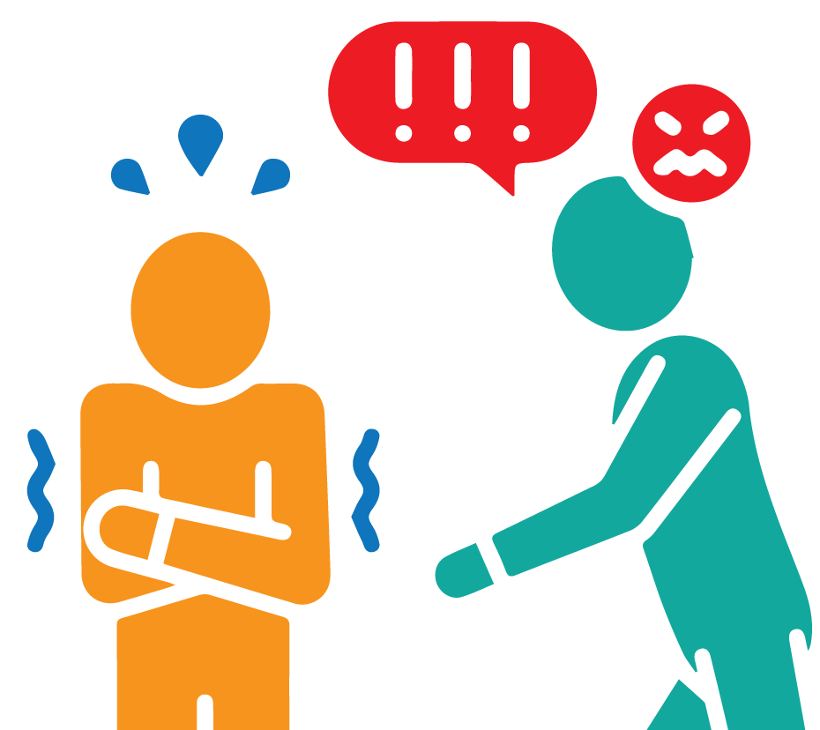
WHAT CAN YOU DO?
Stop harassment
Have the difficult conversations with your staff
Make it clear there is zero tolerance for harassment
Zero tolerance does not mean termination, rather it means, we will coach, mentor, and mediate until the behaviour stops
Be very clear on what harassment is:
Engaging in a course of vexatious comments or conduct against a worker in a workplace that is known or ought reasonably to be known to be unwelcome
Be clear on what harassment is not
Differences in opinions, directing work, emails with a “tone” etc.
Slide 9 of 20
Notes:
A lot of times the complainant will want the respondent to get fired – your concern should not be to appease the complainant, but rather to review the facts and make appropriate decisions based on said facts.

Slide 11
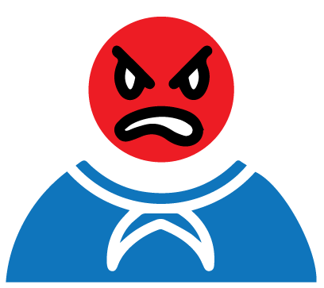
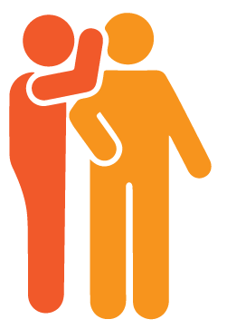
WHEN IS HARASSMENT DETERMINED?
We are all guilty of:
But when does this become harassment?
Gossip
Rudeness
Lying
Exaggeration
Emotions
Nastiness
Slide 10 of 20
Notes:
Basically, any offences of the following (gossip, nastiness, rudeness, etc.) directed at a co-worker would meet the level of harassment, either on multiple occasions, or in some cases a single incident.

Slide 12
WHEN IS HARASSMENT DETERMINED?
Harassment is a course of vexatious comments or conduct…
Consider:
“Look lazy made it in on time – what a miracle!”
“Hey lazy, late for work again!”
“Hey, brought you a coffee to help keep you going, you lazy *&^*”
“Don’t ask her, she is lazy.”
Slide 11 of 20

Slide 13
WHEN IS HARASSMENT DETERMINED?
Tell your employees, if you think you are being harassed – to document it
When: dates, certain shifts it occurs on, etc.
Where: specific locations in the workplace
How: the event or words that transpired
Who: Were there any witnesses?
Slide 12 of 20
Notes:
Part of your workplace harassment policy should include what employees should do in addition to reporting they are being harassed.

Slide 14
WHAT IS NOT HARASSMENT?
Directing work is not harassment
Giving an opinion is not harassment
Having a difference of opinion is not harassment
Emails do not have tone
A single incident may not be harassment depending on the nature of the incident
Slide 13 of 20
Notes:
What does not generally constitute harassment
Carrying out managerial duties where the direction was carried out in a respectful and professional manner
Allocating work
Following-up on work absences
Requiring performance to job standards
Taking corrective or disciplinary measures when justified
Exclusion of individuals for a particular job based on specific occupational requirements necessary to accomplish the safe and efficient performance of the job
Friendly gestures among co-workers such as a pat on the back
The normal exercise of management rights
Supervisory mistakes
Work-related stress
Conditions of work or study
Conflicts
Constructive criticism about the work mistake and not the person
Counseling an employee on his performance appraisal when done in a nondiscriminatory or harassing manner
A single or isolated incident such as an inappropriate remark or abrupt manner

Slide 15
INVESTIGATIONS AND DOCUMENTATION
Don’t be afraid or hesitant to do an investigation – it doesn’t have to be a long-drawn-out process, if it is done effectively, and a clear decision was made.
Gather information
Review information
Make decisions based on the information
Provide results
Slide 14 of 20
Notes:
Trust the process and your own decision-making. If you don’t feel you can be an impartial decision-maker, get a third party to do it.
Expand on the steps listed above.

Slide 16
INVESTIGATIONS AND DOCUMENTATION
Courts, Ministry, and Lawyers all demand the same thing: DOCUMENTATION
Do not skimp on the details
Get the facts, be qualitative, and have evidence
Statements from claimant/respondent
Witnesses' statements
Surveillance video
Text messages/emails
Screenshots
Slide 15 of 20
Notes:
Whatever exists, get the evidence

Slide 17
INVESTIGATIONS AND DOCUMENTATION
Most of Dunk’s investigations as a 3rd party for employers are found to not be harassment
With such a low result of actual harassment cases, what do you think?
Our opinion is that harassment complaints are the result of people not being heard when they have an issue or concern, and a complaint of harassment gets the attention they need.
X
Slide 16 of 20
Notes:
Whatever exists, get the evidence

Slide 18
WORKPLACE HARASSMENT SOLUTIONS
Talk about it
Be very clear on what harassment is and is not
Talk about the consequences – i.e. psychological effects of harassment
What was acceptable even 10 years ago is not acceptable now. Ensure your training reflects that
What is harassment?
Slide 17 of 20
Notes:
Be aware of high-risk workplaces or vulnerable demographics which may have more of a need to do regular check-ins with staff regarding workplace harassment: i.e. places where workplace stress is high, employment of more vulnerable workforce, foreign and youth workers

Slide 19
WORKPLACE HARASSMENT PREVENTION
Better listening
Better communications and managing change in the workplace
Forum for feedback
Town Halls
Address issues of poor behavior early (before it leads to harassment)
One-on-one meetings more frequently for feedback from employees
Especially new hires
Write company values and mission statements
Get the “buy-in’ from employees
Slide 18 of 20
Notes:
If your employees have a complaint about something listen closely. Helping to resolve these issues can nip issues in the bud that have the potential to grow or evolve into workplace harassment.
Examples of inappropriate behaviour that should be addressed:
Always being in a bad mood
Slamming doors
Constantly interrupting colleagues in a meeting
Barging in on colleagues who are having a conversation
Whining about trivial things

Slide 20
Q & A
Thoughts, concerns, opinions…..
Slide 19 of 20

Slide 21
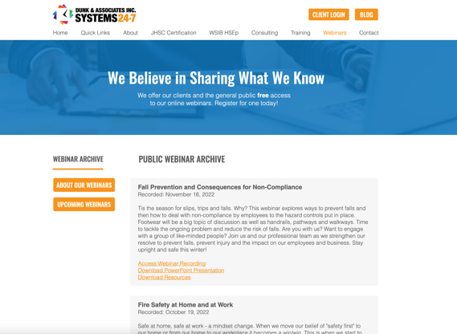
LOVE THIS WEBINAR? HERE’S HOW TO GET THE RECORDING
Dunk & Associates posts webinar recordings in two places:
On our website: https://www.systems24-7.com/webinar-archive
On our YouTube channel: https://www.youtube.com/@systems24-7
Our next webinar is:
“Security in Online Programs and Life Cycle”
April 19, 2023 | 1:00-2:00pm
https://www.systems24-7.com/webinar-schedule-public
Slide 21 of 23

Slide 22
CONNECT WITH US!
Are you subscribed to our newsletters? Each month we share important news, updates, and any changes in legislation across Canada.
We also provide free resources and provide you with links to join our upcoming webinars. If you want to be part of our mailing list, email communications@systems24-7.com.
www.facebook.com/systems247
www.Instagram.com/dunk247
www.linkedin.com/systems-24-7
https://www.youtube.com/
@systems24-7
Slide 20 of 20

