Slide 1
Pre-Use Inspections
You should be able to hear music playing, if not please adjust your speakers or call our office for assistance at 1-866-754-8839. We will be starting promptly at 1pm EST.

Slide 2
Today’s Presenter
Nancy Dunk

Slide 3
Agenda
What are pre-use inspections?
5 Steps of Implementation
  Standard
  Communication
  Train
  Evaluate
  Successes & Improvements

Slide 4
What is a Pre-Use Inspection?
Daily, or planned inspection of the critical components of equipment or systems that have a high potential for causing serious injury or illness.
  Daily, per use or per KM/Hours Used.
On-the-spot recording of findings.
Ensures the equipment meets minimum acceptable safety requirements.
Often part of preventive maintenance procedure or hazard control program.

Slide 5
Why complete a pre-use inspection?
Pre-use inspections are used for equipment that pose risks to the employees well being. It is imperative to ensure the equipment is functioning properly before it is used by employees.
Assists in identifying and controlling existing and potential hazards.
Determine underlying causes of hazards.
Help reduce the frequency of injuries, illness or property damage as a result of damaged or faulty equipment.
Recommend corrective actions.
Monitors steps taken to eliminate hazards and control the risks.

Slide 6
Why complete an inspection?
Pre-use inspections also may result in:
Increased productivity
Lower maintenance costs
Great equipment longevity
Better procurement decisions
More accurate cost forecasting
Reduced loss-time incidents
Liability protection

Slide 7
Step # 1 – Set a Standard
Items to be included in your standard:
Purpose
Identify Roles and Responsibilities
  What role and responsibilities will owners, managers/supervisors, and employees take on?
Procedure
  How will pre-use inspections be completed?
Identify who will be trained and how.
  Who will the policy apply to?
Evaluation
Required Forms
Legislation/Standards / Regulations

Slide 8
Identify Roles & Responsibilities
Employers / Business Owners
Create and maintain an inventory of equipment that requires pre-use inspections, as well a process for storing and reviewing the records generated from the inspections.
Set the procedure and process parameters for conducting pre-use inspections.
Determine who will be the record keeper for the pre-use inspections and the length of time the records will be kept for.
Example: At Acmemart, there are 5 cardboard compactors. They are to be inspected at the beginning of each workers’ shift using the pre-use checklist provided. On the 28th day of each month, the Supervisor collects all the pre-use inspections and reviews them for completeness and to identify trends with the equipment. The findings of the Supervisor review will be shared at the H&S meeting on the 2nd Tuesday of each month.

Slide 9
Identify Roles & Responsibilities
Managers / Supervisors
Ensure the procedure and process are followed for pre-use inspections.
Implement, collect and confirm the pre-use inspection information.
“Go-To” person when deficiencies are identified. If there is a simple fix, the manager/supervisor can correct the deficiency. If the fix is beyond their abilities, they will lockout/tagout the equipment and determine the next steps.
“Buy In” Mindset. Managers and Supervisors must appreciate the inspections are valuable and worthwhile to protect the safety and wellbeing of employees.

Slide 10
Identify Roles & Responsibilities
Employees
Complete the pre-use inspection as outlined in the procedure.
Pay close attention to the equipment in use and bring forward any potential issues or deficiencies.
Only use equipment after completing the pre-use inspection and deeming no deficiencies or threats to safety.
Must be trained on safe operation of the equipment, as well as items to keep an eye out for in terms of deficiencies, issues, etc.
“Buy In” Mindset. Employees must appreciate the inspections are valuable and worthwhile to protect their safety and wellbeing.

Slide 11
Setting the Procedure
Your procedure must:
Identify the list of items (inventory) to be inspected.
Outline the frequency of inspections (i.e. daily, at each new use, etc.)
Explain how the pre-use inspection will be completed.
List what is to be inspected – usually from operator/owners’ manual
Include or reference the recording mechanism to track and maintain records of the inspections.

Slide 12
Setting the Procedure
Generally, a pre-use inspection is completed in a checklist form. Pre-use inspections can also be completed in formats such as logbooks or forms. The format for peruse inspections must be outlined in the procedure.
The format selected must outline the components to be inspected before the employee begins working with that piece of equipment.
The format must include space to record deficiencies or hazards identified as a result of the inspection.
The format must also include recommendations for corrective action.
The format must include the date and a signature of the employee who completed the inspection.

Slide 13
Setting the Procedure
As in all Health and Safety items, there is no easy, simple “one size fits all” approach or checklist for all machinery or equipment. You must customize your pre-use inspection procedure to ensure all items are well thought out and considered. The checklist must be simple to use and have specific details about the equipment.
Examples of items to consider:
All safety interlock switches function properly.
All emergency stop buttons are functioning properly.
All guards in place.
Electrical cords are in good condition with no cuts, frays, exposed wiring.
The machine is in good operating order (no unusual smells or sounds).

Slide 14
Setting the Procedure
Pay attention to items that are most likely to result in unsafe conditions. Consider the affects below on your pieces of equipment or machinery:
Wear
Impact
Vibration
Heat / Temperature Fluctuations
Corrosion
Chemical Reaction
Ventilation
Misuse
Look up, down, around and inside. Be methodical and thorough. Safety depends you the quality of the inspection.

Slide 15
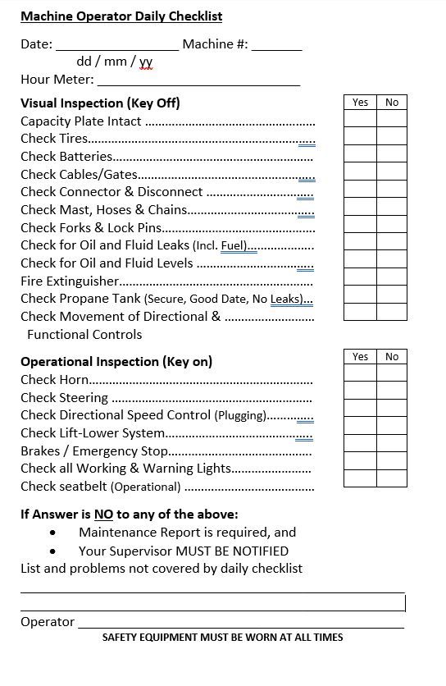
Setting the Procedure - Example

Slide 16
Setting the Procedure
While setting the procedure for pre-use inspections, you must determine what steps will be taken when a deficiency is identified.
Your procedure must include:
When a deficiency is identified, what is it, and how to record.
Who must be notified of the deficiency.
What steps should be taken if the deficiency can be easily rectified, and how that will be recorded.
What to do when deficiencies identified cannot be remedied, and who needs to be contacted.

Slide 17
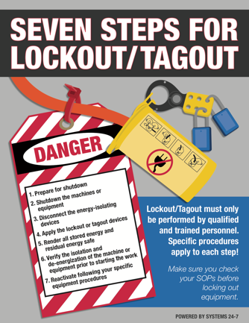
Step # 2 – Communication
Once your standard is in place, you must communicate the expectations with employees. The more the standard is communicated to employees in varying methods of delivery, the better!
Consider:
Safety Talk
Posters
Emails
Group chats or huddles
One-on-one conversations
Small group discussions
Phone calls
Text blasts

Slide 18
Step # 2 – Communication
Remember when you are communicating with employees, the various literacy levels, hearing impairments, language requirements, etc. Plan to communicate in a multitude of ways to ensure employees understand the message.
As always, keep a record of what was communicated when and how.

Slide 19

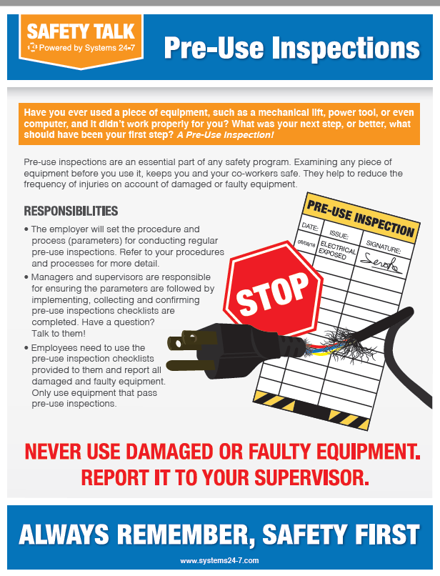
Communication Examples
Yes, these examples (and many others) are available for use ask Dunk for what you need!

Slide 20
Step # 3 – Train
Once your standard has been set and you have communicated the expectations to employees, you must train employees on how to complete a pre-use inspection.
When training your employees on the inspections, ensure:
All and any employees who use a piece of equipment requiring a pre-use inspection MUST be trained on the inspection process before using the equipment.
Hands on experience. Theory is good, but without seeing and identifying the components to look for, employees may not know what to do.
Stress the value and importance of the inspections, to the employees and to the business.
Allow ample time for questions and additional training.

Slide 21
Step # 3 – Train
Ask employees questions and provide test scenarios. For example, if the cardboard compactor’s guard is broken, what do you do? Who would you tell? Why? Would you use the cardboard compactor?
If possible, show the employees what a faulty piece of equipment looks like.
Constantly revisit the training and the employees’ comprehension of the inspections.
Review completed inspections and ask questions. For example, on May 14th 2020, you noted the electrical cord was stripped but no action was taken. On May 15th 2020, there was no reports of the electrical cord being stripped. Was it fixed? Who fixed it? Or is it still stripped?
Show employees you are actively involved in the process.

Slide 22
Step # 3 - Train
Remind and empower employees to look beyond the checklist.
Don’t allow employees to fall into a pattern where they mindlessly check the equipment each day before use.
Avoid placing so much focus on noting specific details on the checklist, that the employees miss glaring hazards.
Example:
The compressor is in working order, but the vibrations from constant use has shifted the boxes stored above the compressor and are near falling from the shelf above.

Slide 23
Step # 3 - Train
Avoid providing an arbitrary time value to complete a pre-use inspection. It is difficult to accurately estimate how long each inspection will take as many factors impact the inspection. For example, if a deficiency is found, it will take longer than when a deficiency is not found. The same applies for simple machinery to a large, complex piece of equipment.
Inspections are ineffective when the given time allows for only a quick look. Allow employees time to diligently inspect the equipment before use. However, that doesn’t mean a pre-use inspection will take 45 minutes in the morning while the employee drinks their coffee.

Slide 24
Step # 4 - Evaluation
It is imperative to evaluate your pre-use inspection procedures regularly. Consider spot checking a predetermined amount of inspections per week.
Ensure to review your standard as new pieces of equipment or machinery are introduced, or as legislative requirements change.
Inspection records will also show where previous inspection teams focused on and will show if controls and measures put in place were effective.
Ask employees for feedback! Are the pre-use inspections working? Should items be added or removed from the list to check?
What impact are pre-use inspections having on the workers? Are there any direct or indirect impacts?

Slide 25
Step # 5 – Success & Improvements
Once you’ve completed Steps 1 through 3 and then evaluated your efforts, it’s time to see what was a success and what needs some work.
Using the findings from your evaluation, determine if the topic is living and breathing in the workplace.
If you determine it is, AWESOME! Acknowledge the work and efforts of those who have made pre-use inspections successful.
If you find only part of the pre-use inspection process is being followed, identify the areas of concern and address them. If you find something is not working and you don’t do anything about it, that can be considered negligence.
If nothing related to your pre-use inspection process is working, start from the beginning. Use the findings from your evaluation to determine where it went sideways and correct it. Perhaps the checklists you have are great and will be effective, but the roles and responsibilities in your standard were not clear and no one took ownership. Don’t reinvent the wheel, fix the squeaks!

Slide 26
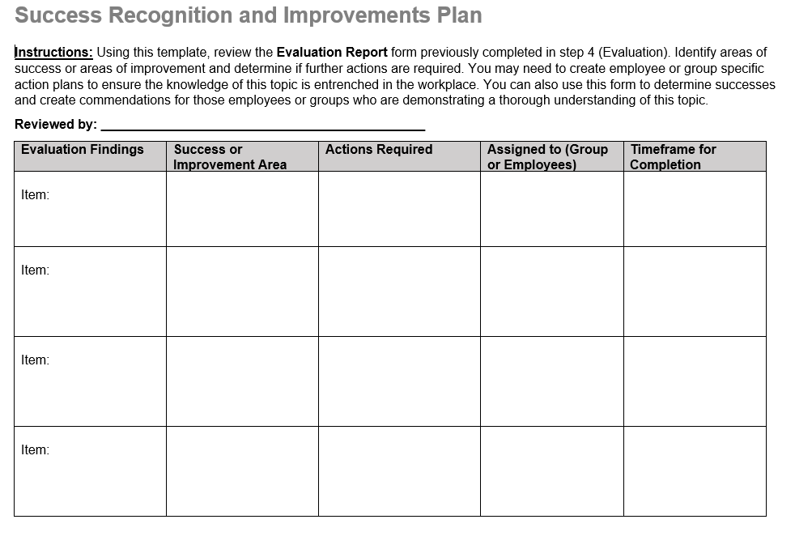
Step # 5 – Success & Improvements
We have an Action Plan for that!

Slide 27
Call to Action
When was the last time you spot checked a completed pre-use inspection?
Do you have any equipment or machinery that doesn’t currently have a pre-use inspection completed before use? Should it?
Is your inventory of pre-use inspection required equipment current?

Slide 28



Any Questions?
Make sure to get connected by following us on social media! We share tips and important information about your programs and services.
Let’s talk!

Slide 29


