Slide 1
SECURITY IN ONLINE PROGRAMS

Slide 2
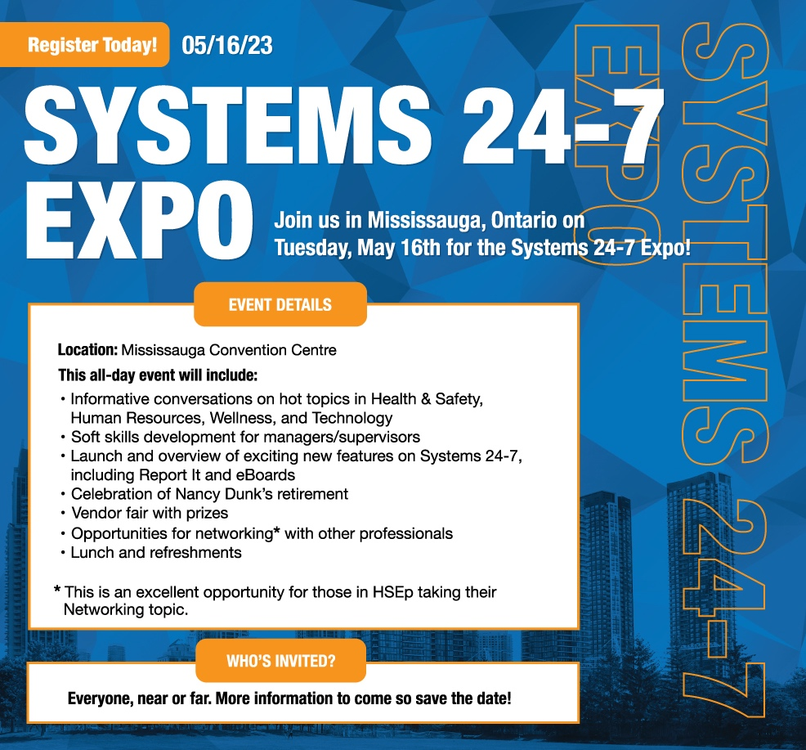
For more information visit:
www.systems24-7.com/systems24-7expo

Slide 3
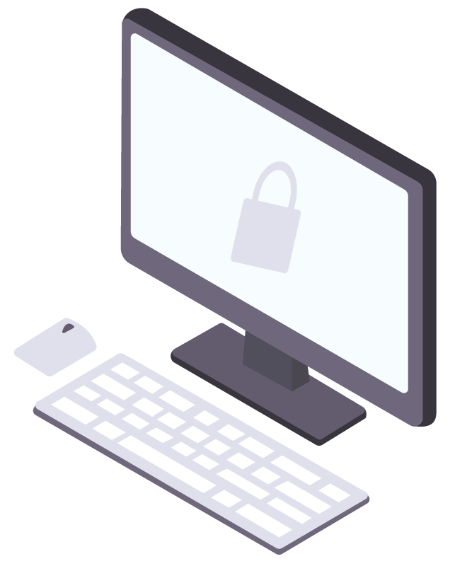
ONLINE SECURITY
Online security is not just a luxury but a necessity for everyone who uses the internet.
When using online programs and websites, it's essential to be aware of the security features that you should look for to ensure your data is protected.
Slide 3 of 16

Slide 4
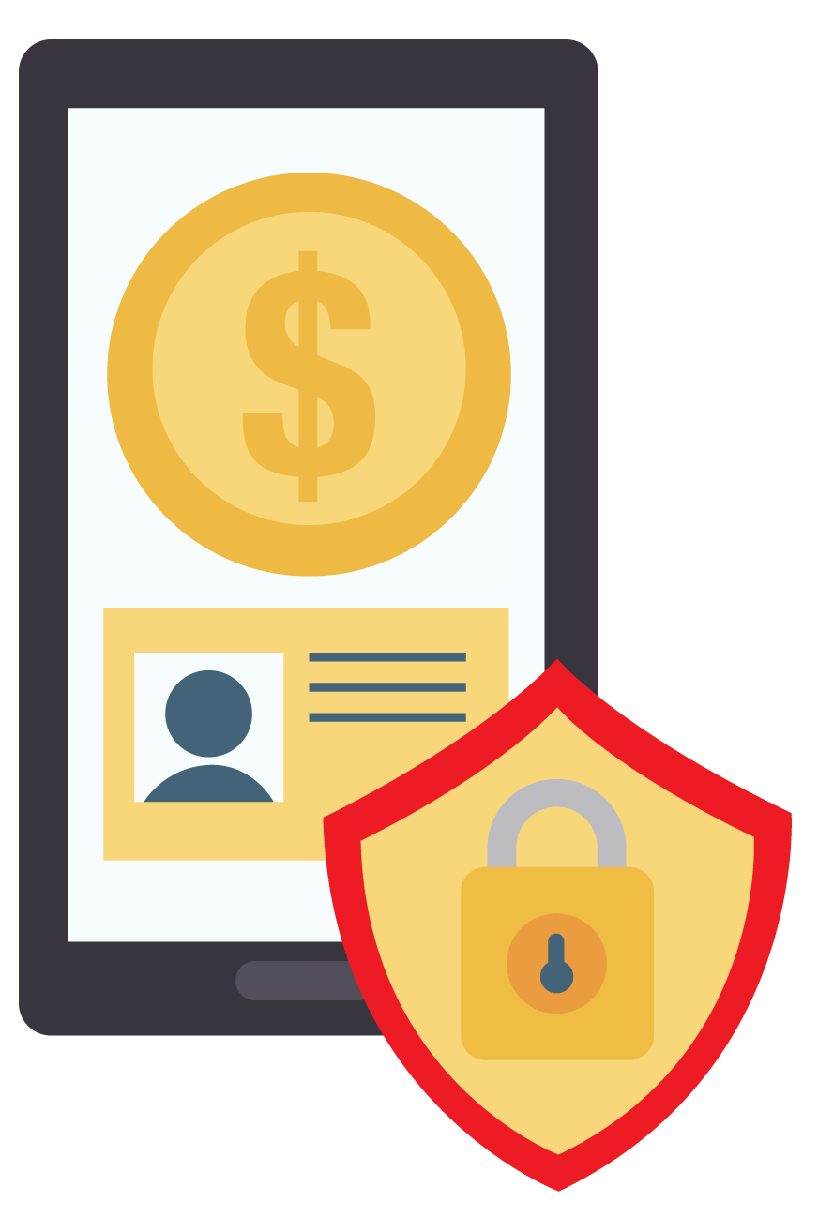
ONLINE SECURITY
There are several reasons why some people believe that online security is a luxury and that they don't need it. One common reason is the belief that online security is too expensive. Some people may believe that investing in online security measures is a waste of money, especially if they don't use the internet for sensitive transactions such as online banking. However, the reality is that online security is a necessity, and the cost of not investing in it can be much higher than the cost of investing in security measures.

Slide 5
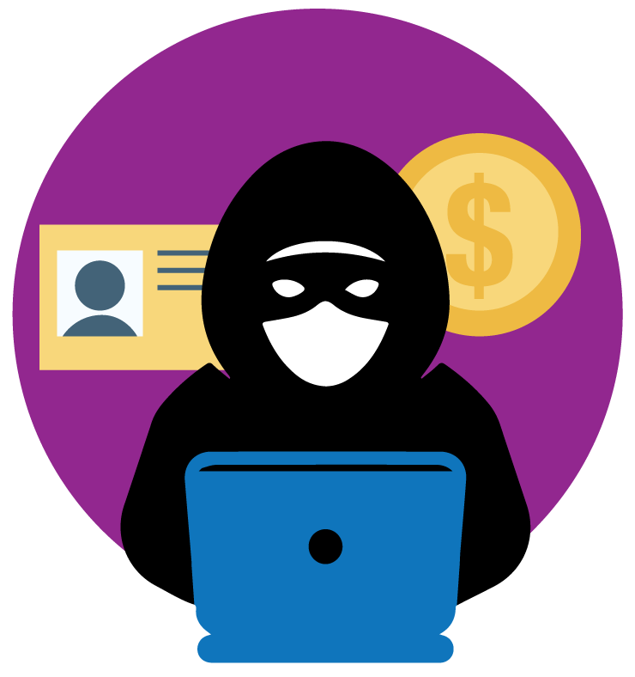
ONLINE SECURITY
Another reason some people believe that online security is a luxury is the misconception that they are not significant enough for hackers to target. Some people may believe that they don't have anything valuable online, so there's no point in investing in online security. However, this is a dangerous assumption because hackers don't just target high-profile individuals or organizations. They can target anyone, and even small breaches can lead to significant consequences such as identity theft or financial loss.

Slide 6
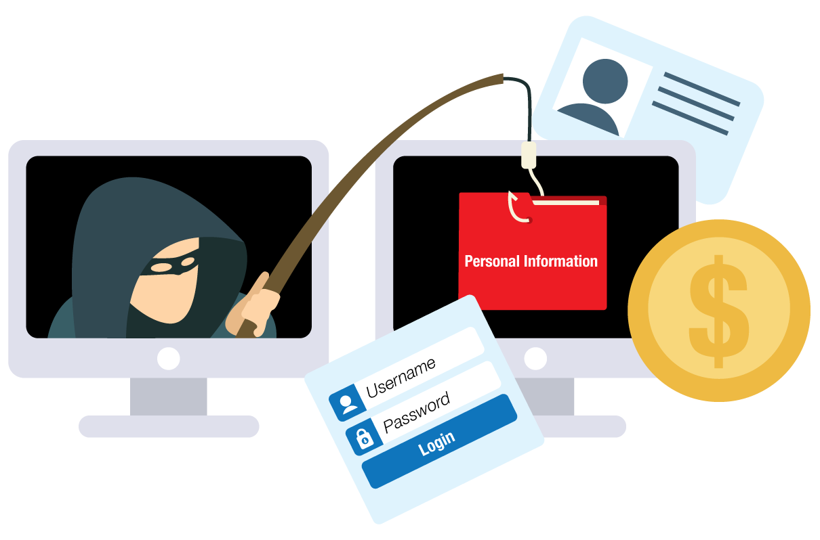
ONLINE SECURITY
Some people also believe that what they are doing online doesn't matter if it gets breached. For example, they may think that if someone hacks their social media account, it's not a big deal because it's just social media. However, this is a dangerous mindset because the information stored in social media accounts can be valuable to hackers. For example, they can use personal information to answer security questions for other accounts or use the information to create convincing phishing scams.

Slide 7
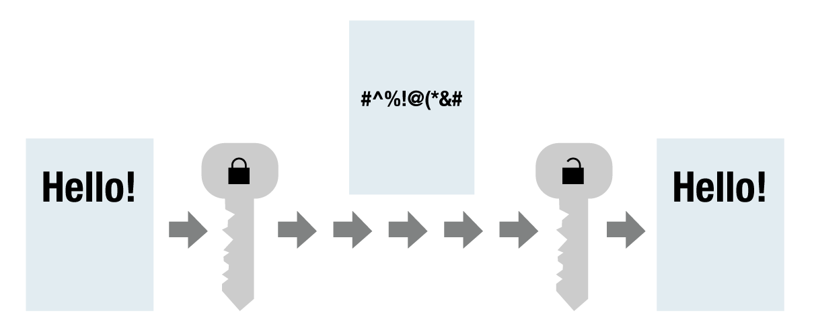
HERE ARE SOME OF THE KEY SECURITY FEATURES TO KEEP IN MIND
Encryption: Encryption is the process of converting data into a code to protect it from unauthorized access. To ensure that a website or online program is using encryption, look for a padlock icon in the address bar or check that the URL starts with "https.”
Strong password requirements: Strong passwords are essential for protecting your accounts from unauthorized access. When signing up for a new online program or website, ensure that they require strong passwords containing at least eight characters with a mix of upper and lower case letters, numbers, and symbols.

Slide 8
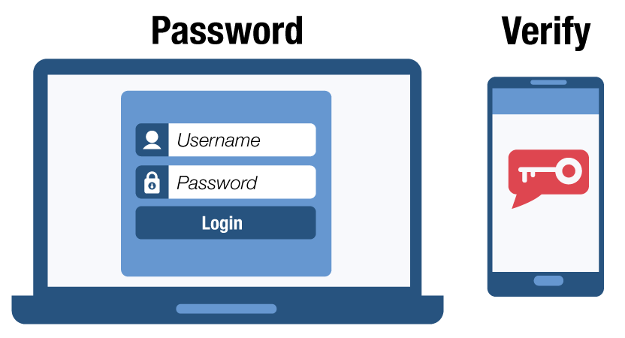
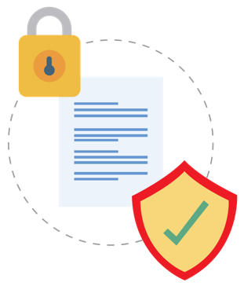
HERE ARE SOME OF THE KEY SECURITY FEATURES TO KEEP IN MIND
Two-factor authentication (2FA): 2FA adds an extra layer of security to your accounts by requiring you to provide two different types of authentication before accessing your account. Check that the website or online program offers 2FA as a security feature.
Privacy policy: A privacy policy explains how a website or online program collects and uses your data. To ensure that your data is protected, always read the privacy policy of any website or online program you use.
Regular updates: Regular updates are essential for fixing security vulnerabilities and bugs in online programs and websites. Check that the website or online program is regularly updated to ensure your data is protected.

Slide 9
FIREWALLS
Firewalls are a key security feature for protecting your device from unauthorized access. A firewall is a network security system that monitors and controls incoming and outgoing network traffic based on predetermined security rules. To ensure that your device is protected by a firewall, check that your operating system has a built-in firewall or install a third-party firewall.

Slide 10
ANTI-VIRUS SOFTWARE
Anti-virus software is essential for protecting your computer from malware and viruses that can compromise your data. Check that your computer has anti-virus software installed and that it is up-to-date with the latest virus definitions.

Slide 11
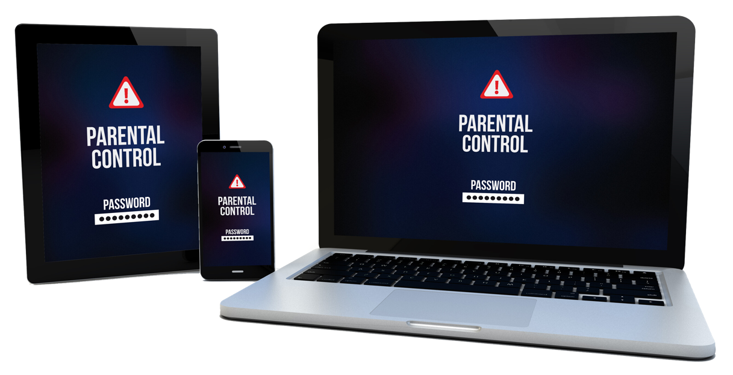
PARENTAL CONTROLS
Parental controls are an essential security feature for protecting children when using online programs and websites. Check that the website or online program offers parental controls to limit access to inappropriate content.

Slide 12
DATA BACKUP
Data backup is critical for protecting your data from loss or theft. Check that the website or online program offers automatic backup services or manually backup your data regularly.

Slide 13
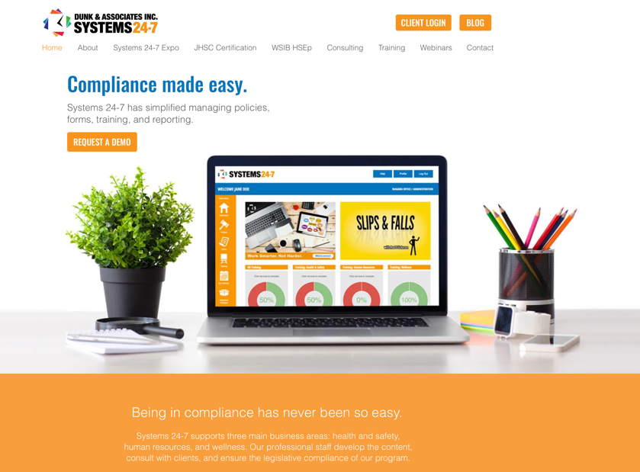
USER-FRIENDLY INTERFACE
A user-friendly interface is essential for avoiding mistakes that could compromise your security. Check that the website or online program has a simple and intuitive interface to navigate easily.

Slide 14
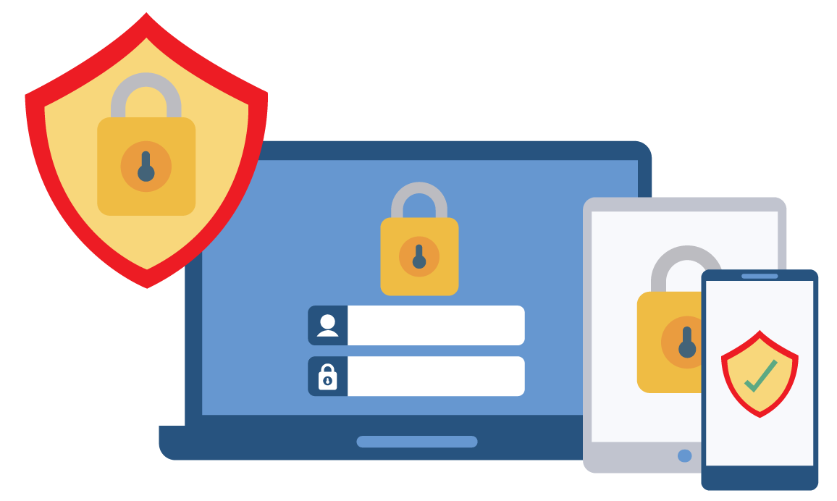
CONCLUSION
In conclusion, online security is a necessity, and by understanding the security features of online programs and websites, you can better protect yourself from security threats. Ensure that the website or online program you use has encryption, strong password requirements, 2FA, a privacy policy, regular updates, firewalls, anti-virus software, parental controls, data backup, and a user-friendly interface. By following this checklist, you can ensure that you are protected when using the internet.
Slide 14 of 16

Slide 15
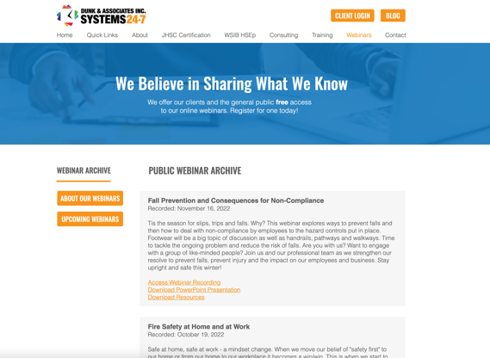
LOVE THIS WEBINAR? HERE’S HOW TO GET THE RECORDING
Dunk & Associates posts webinar recordings in two places:
On our website: https://www.systems24-7.com/webinar-archive
On our YouTube channel: https://www.youtube.com/@systems24-7
Our next webinar is:
“Coaching Clinic (HR and Safety)”
May 9, 2023 | 1:00-2:00pm
https://www.systems24-7.com/webinar-schedule-public
Slide 15 of 16

Slide 16
CONNECT WITH US!
www.facebook.com/systems247
Are you subscribed to our newsletters? Each month we share important news, updates, and any changes in legislation across Canada.
We also provide free resources and provide you with links to join our upcoming webinars. If you want to be part of our mailing list, email communications@systems24-7.com.
www.instagram.com/dunk247
www.linkedin.com/systems-24-7
https://www.youtube.com/
@systems24-7
Slide 16 of 16

